Slide 1
Neural Architecture Search
Sun, Yue

Slide 2
Contents
NAS
HPO
Autogluon

Slide 3
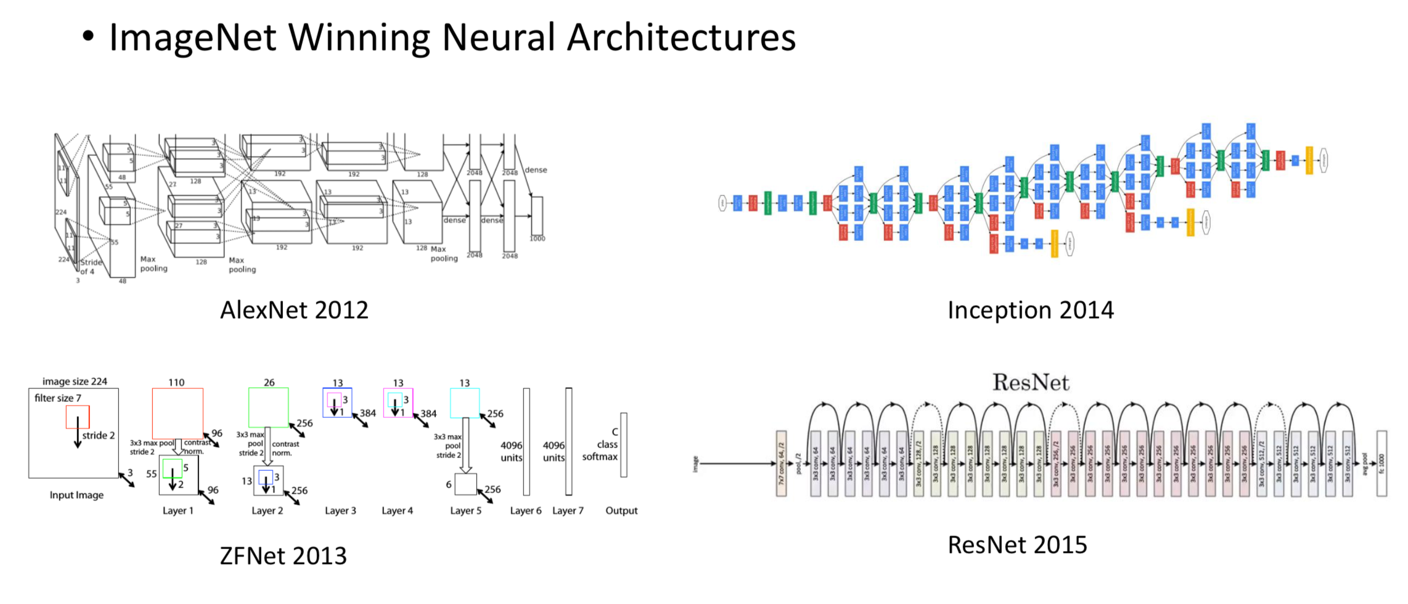
The Architecture of a Neural Network is Crucial to its Performance
https://gluon-cv.mxnet.io/model_zoo/classification.html

Slide 4
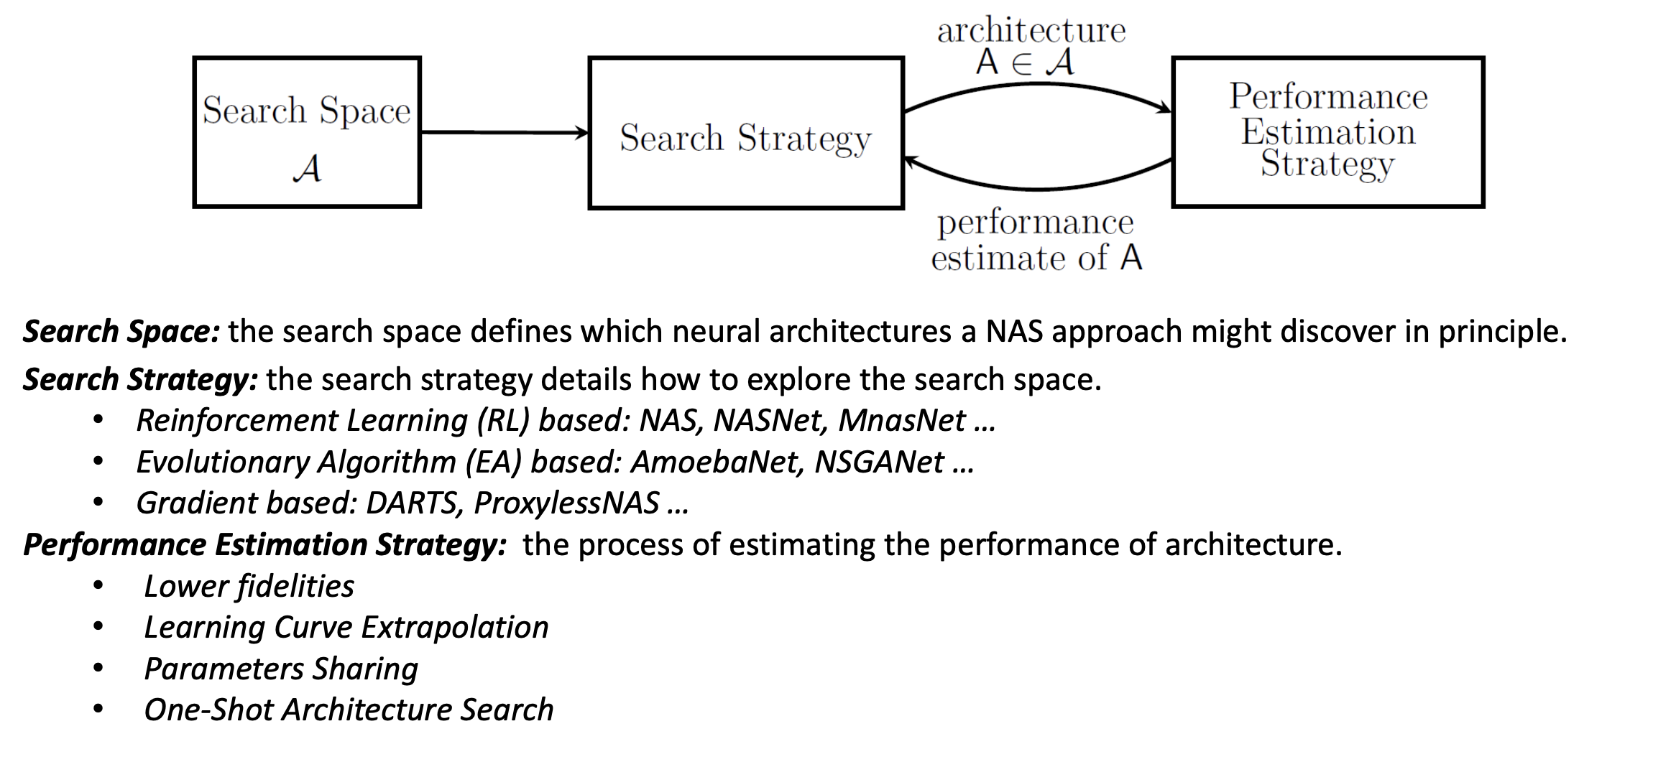
Neural Architecture Search （NAS）
Neural Architecture Search can be divided as three parts:

Slide 5
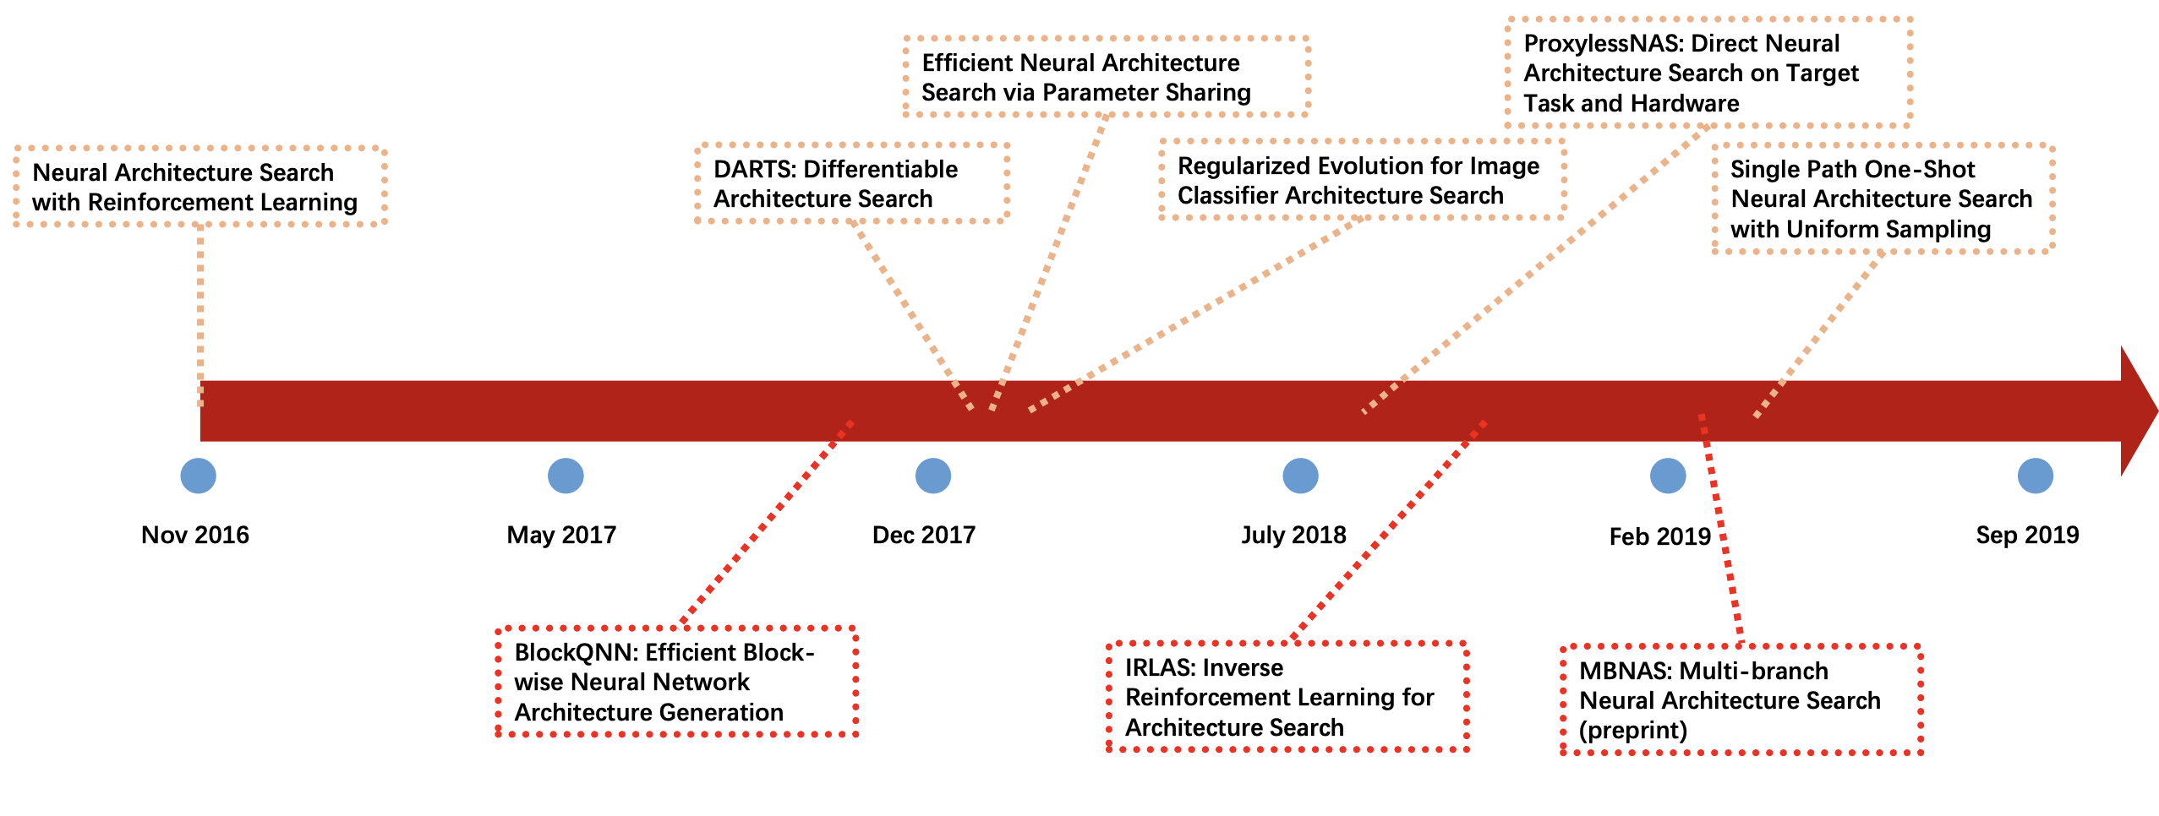
Time line of NAS

Slide 6
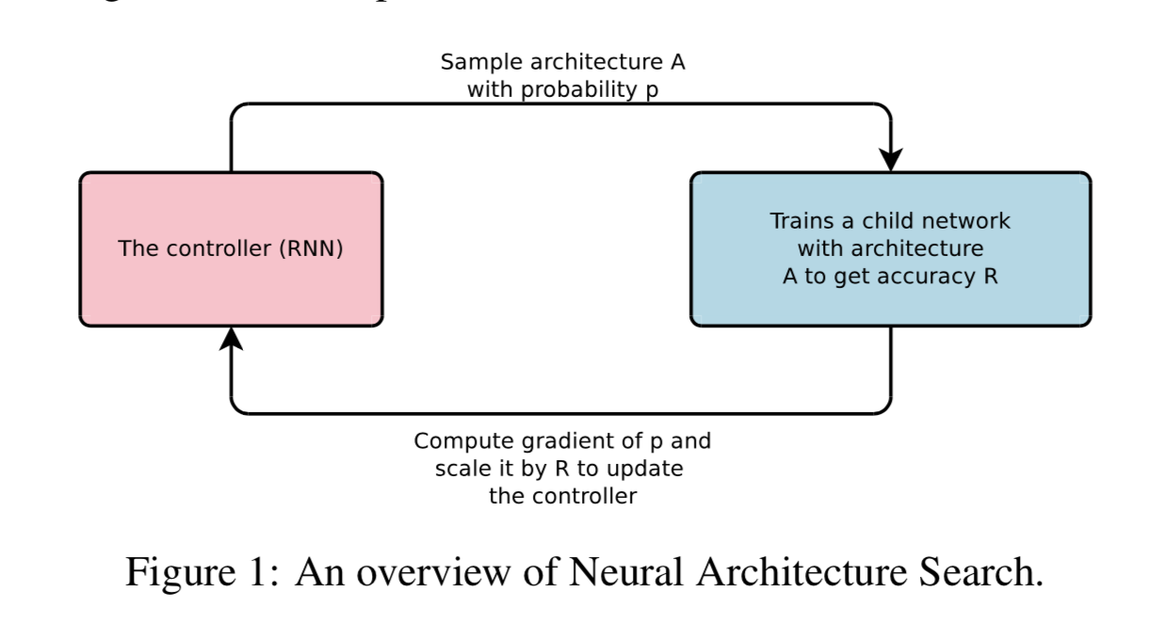
NAS
Key point: Generate Recurrent Architectures
use a controller to generate architectural hyperparameters of neural networks (as a sequence of tokens)
filter height, filter width, stride height, stride width, and number of filters for one layer and repeats.
reward signal R is non-differentiable, a policy gradient method which we use to update parameters θc (θc, are then optimized in order to maximize the expected validation accuracy ) REINFORCE rule from Williams.(1992)

Slide 7
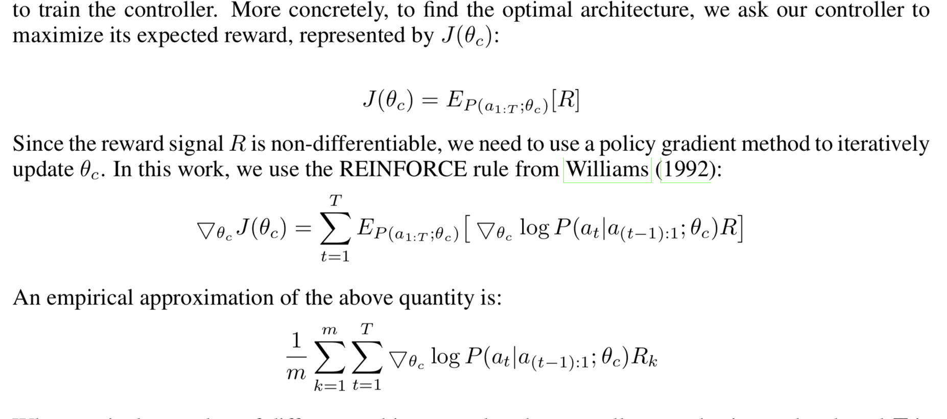

NAS

Slide 8
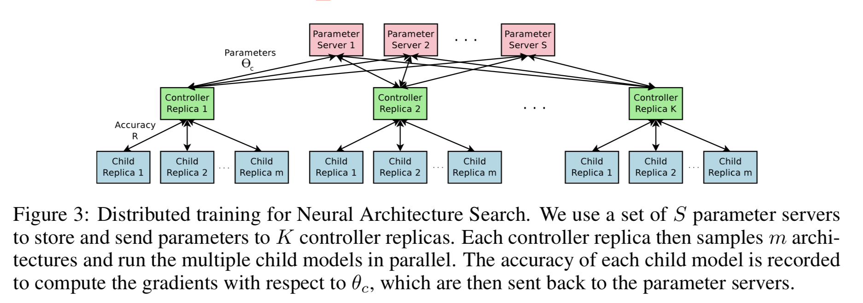
NAS
S parameter servers; K controller replicas; sample m child network;
Each child model is recorded the θc to update.

Slide 9
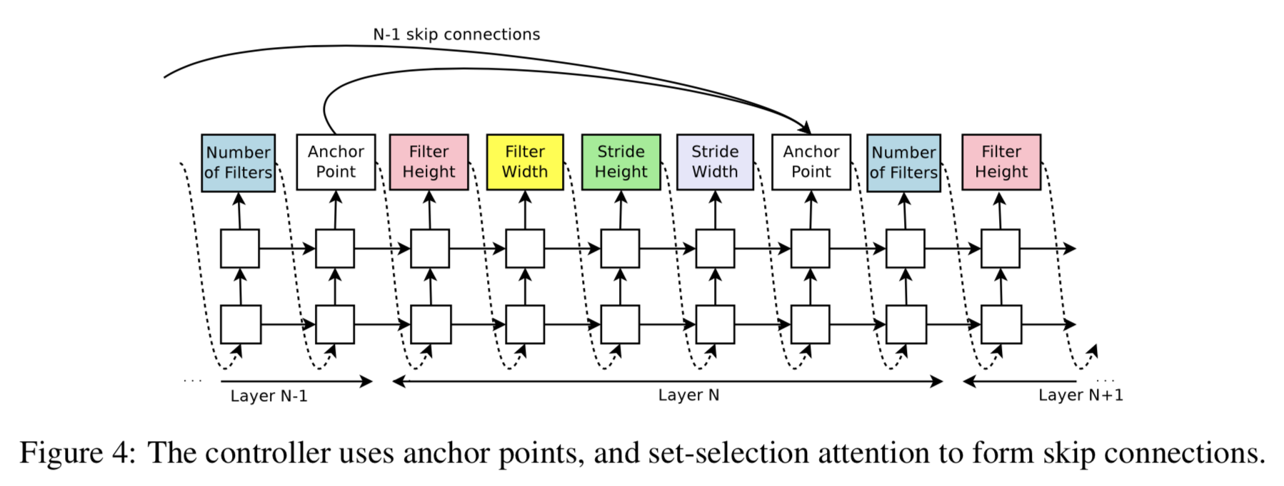
NAS
To enable the controller to predict skip connections like Resnet.
At layer N , we add an anchor point which has N − 1 content-based sigmoids to indicate the previous layers that need to be connected.

Slide 10
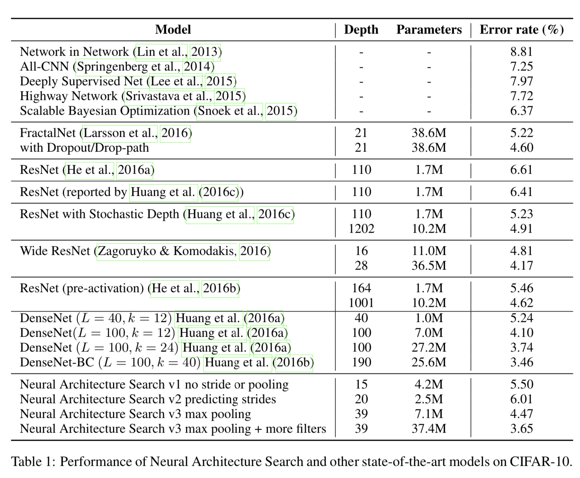
Experiment:
Dataset:Cifar10
Space: For every convolutional layer,
a filter height in [1, 3, 5, 7]
a filter width in [1, 3, 5, 7],
a number of filters in [24, 36, 48, 64].
For strides, we perform two sets of experiments, one where we fix the strides to be 1, and one where we allow the controller to predict the strides in [1, 2, 3].
Details: a child model is constructed and trained for 50 epochs. The reward used for updating the controller is maximum validation accuracy of the last 5 epochs
800 K40 * 28days (Cifar)

Slide 11
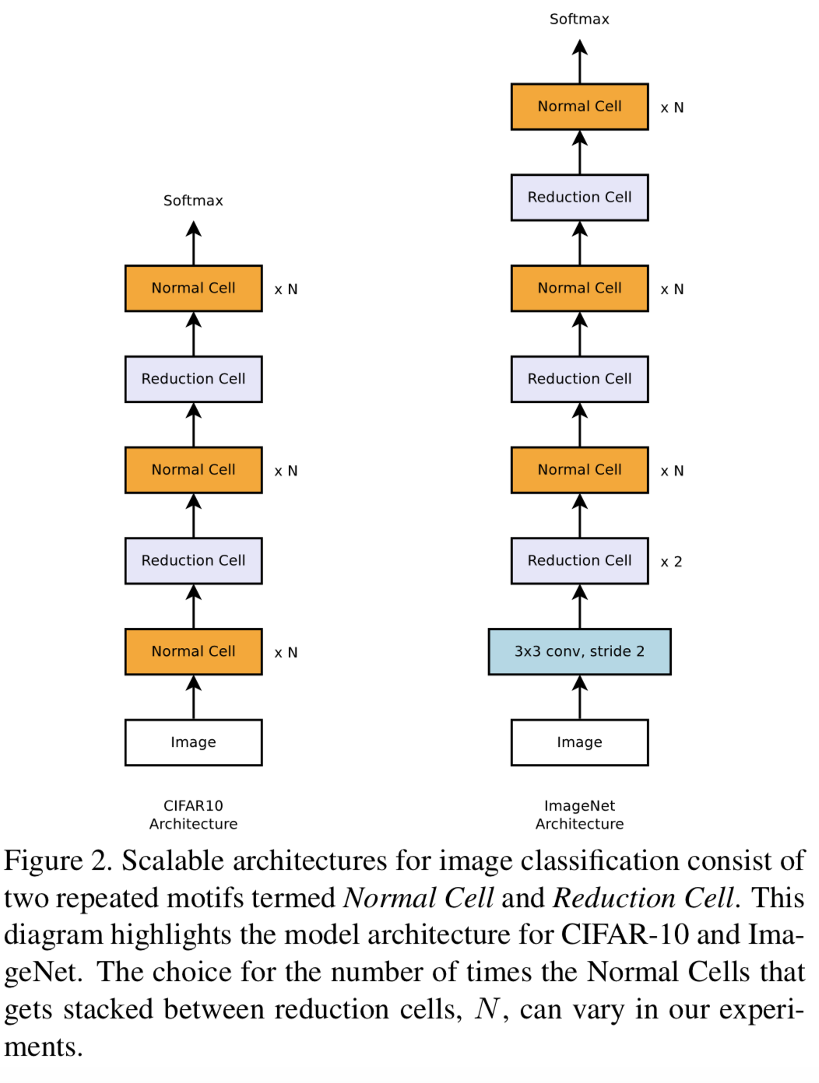
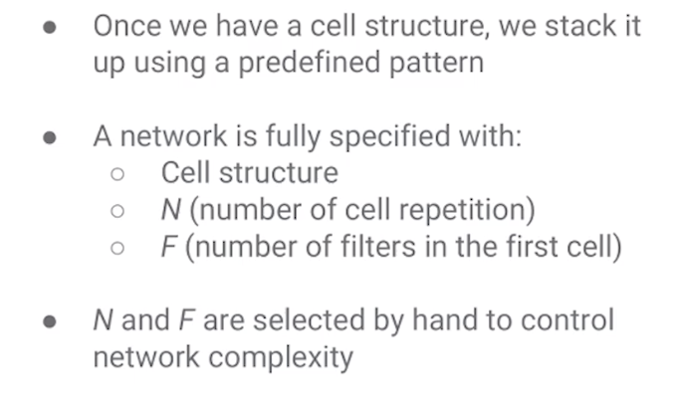
Search Space
Similar to Zoph et al.(2018)
NASNet
Cell->Network

Slide 12
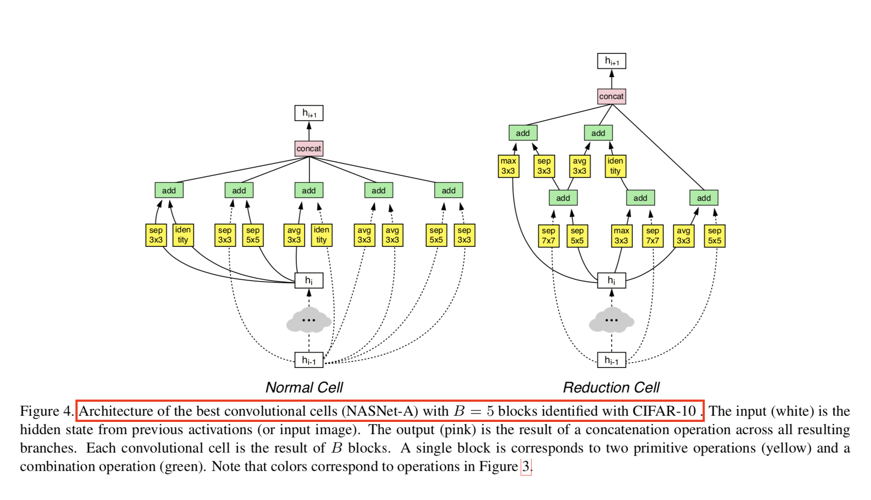
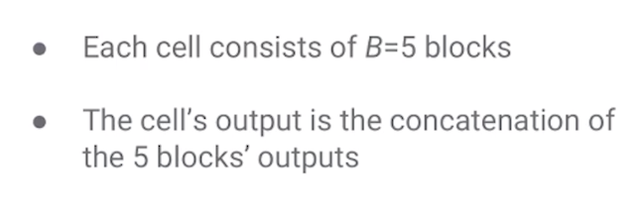
Search Space
Block->Cell

Slide 13
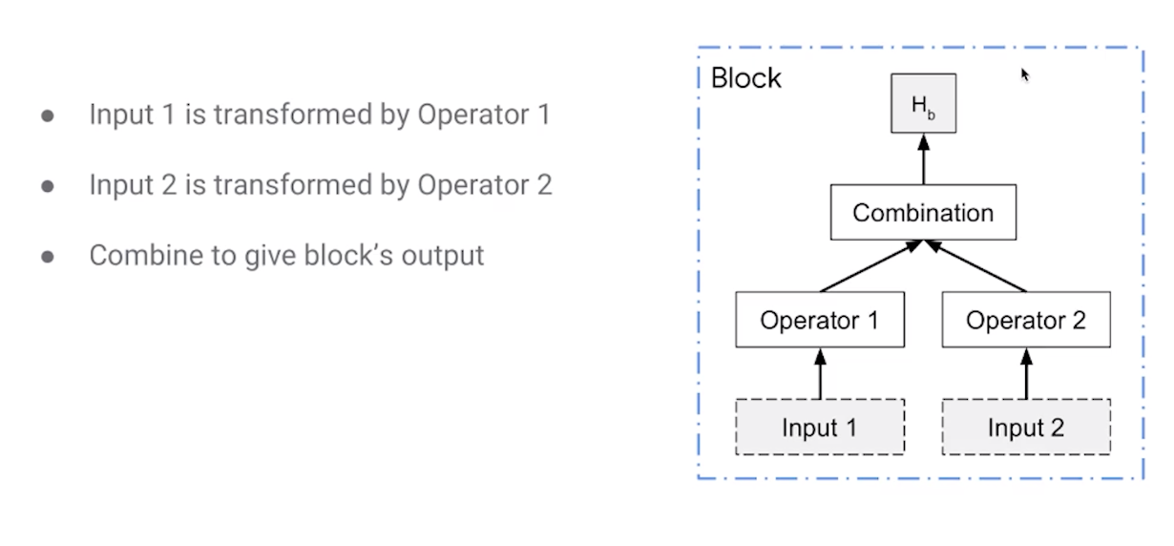

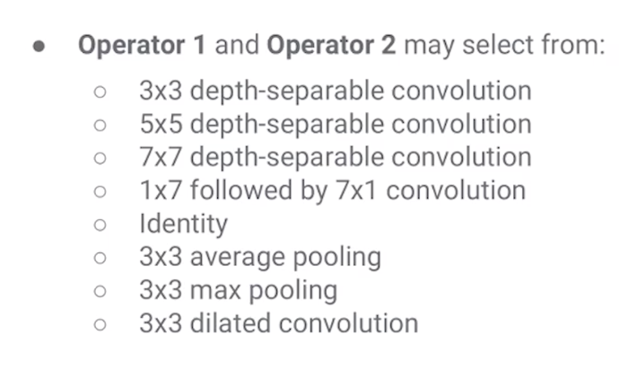
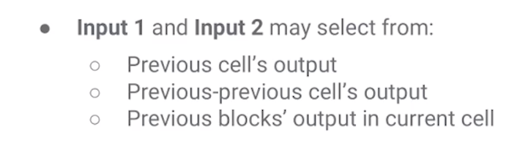
Search Space
Within a block

Slide 14
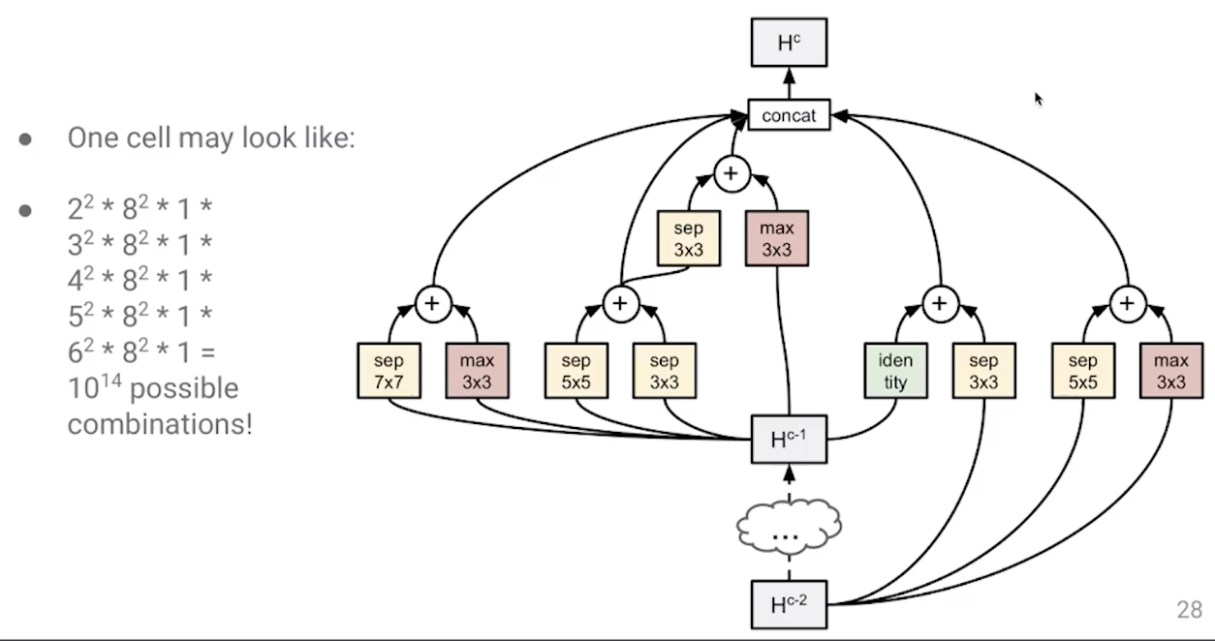
Architecture Search Space Summary
每一个+ 表示一个block结束，elementwise addition
前两个cell 以及前一个cell的output
Network的结构提前定义不搜索，
Cell的search space已经非常大了
random search is a difficult baseline to beat .
500 K40 * 4 days (cifar10)

Slide 15
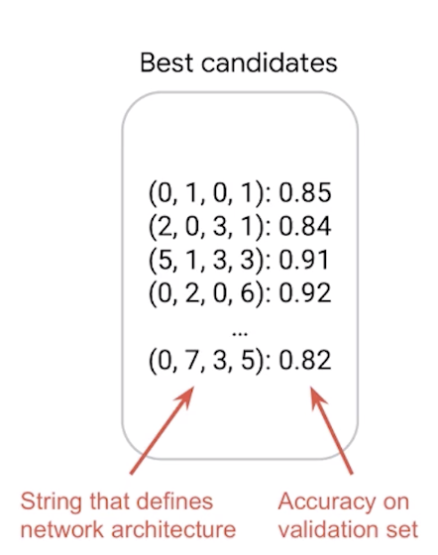
Evolutionary Algorithms for NAS
AmoebaNet

Slide 16
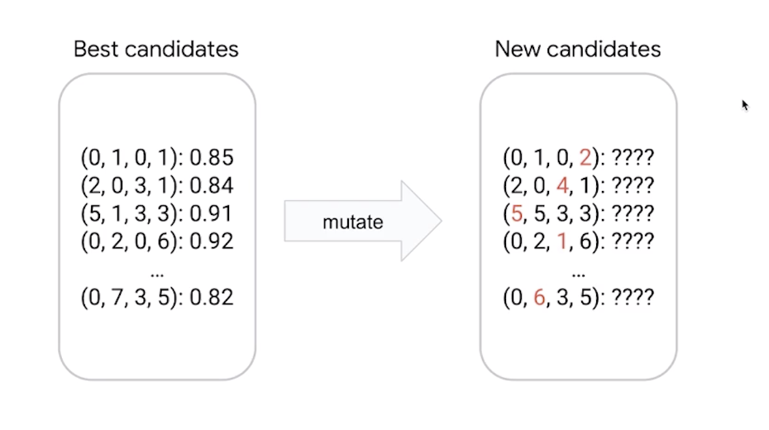
Evolutionary Algorithms for NAS

Slide 17
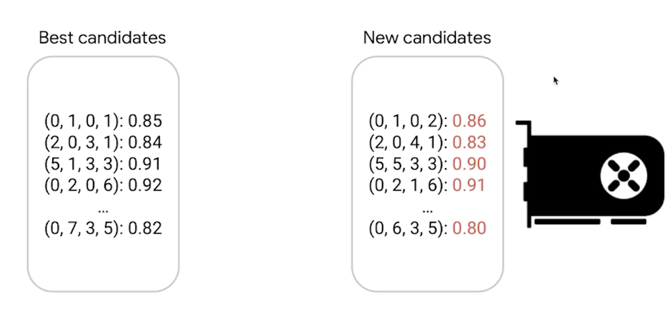
Evolutionary Algorithms for NAS

Slide 18
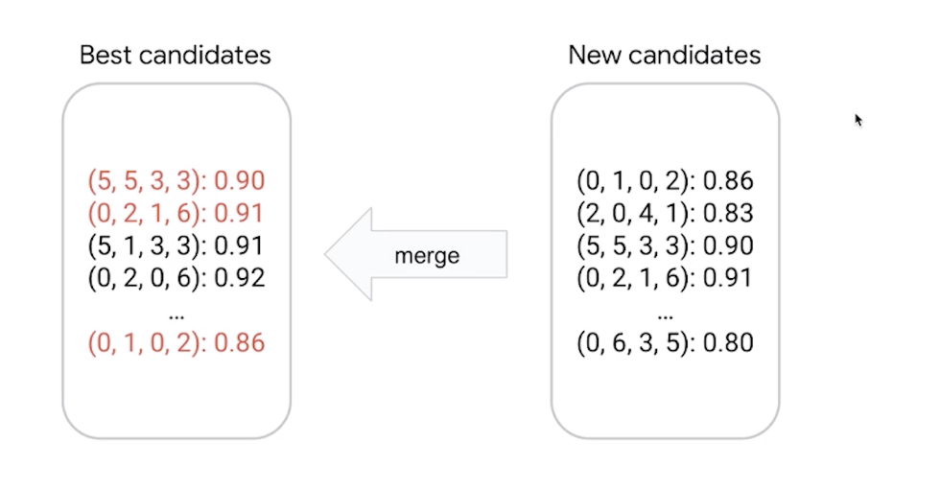
Evolutionary Algorithms for NAS

Slide 19
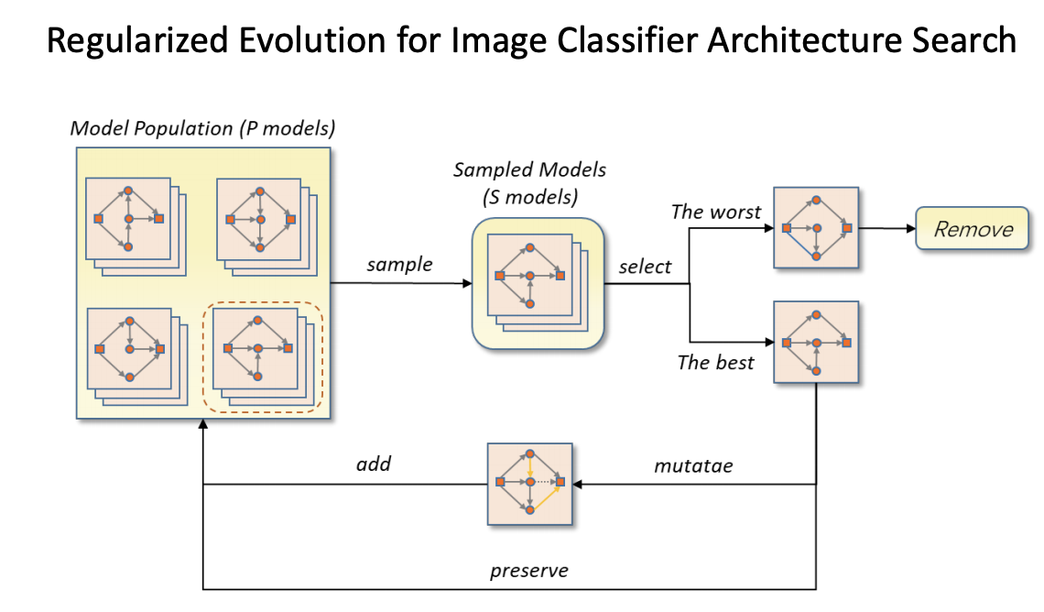
Evolutionary Algorithms for NAS
450 K40 * 7 days (cifar10)

Slide 20
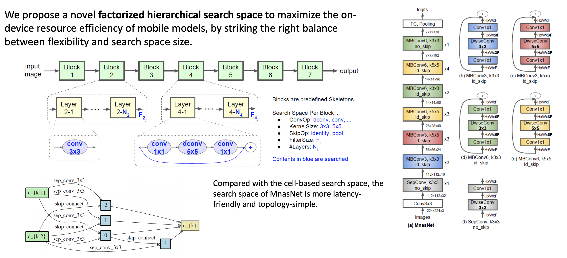
Search Strategy
Mnas

Slide 21
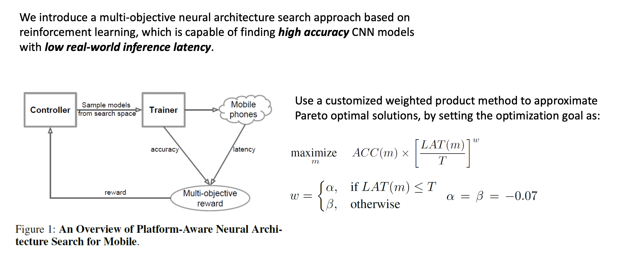
Search Strategy
Mnas

Slide 22
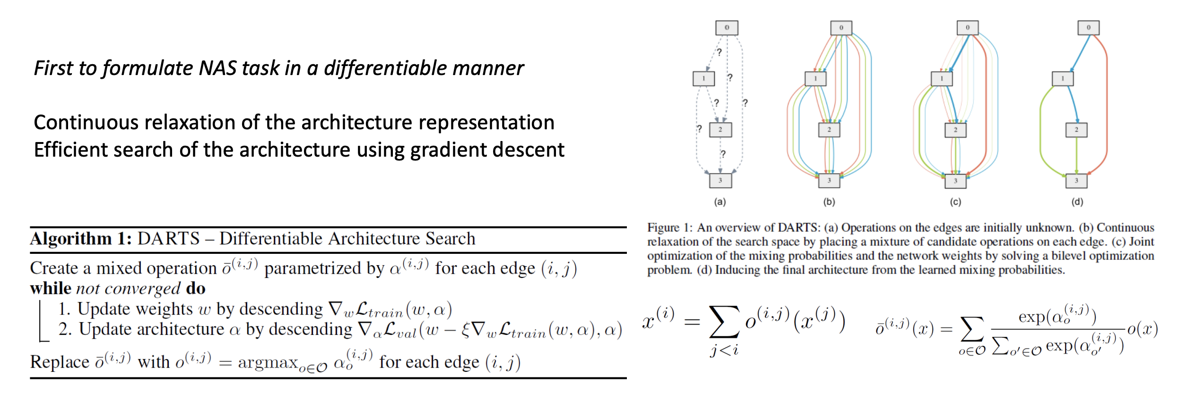
Search Strategy
Darts（Gradient- based）
we have a bunch of a powerful gradient-based optimization algorithms

Slide 23
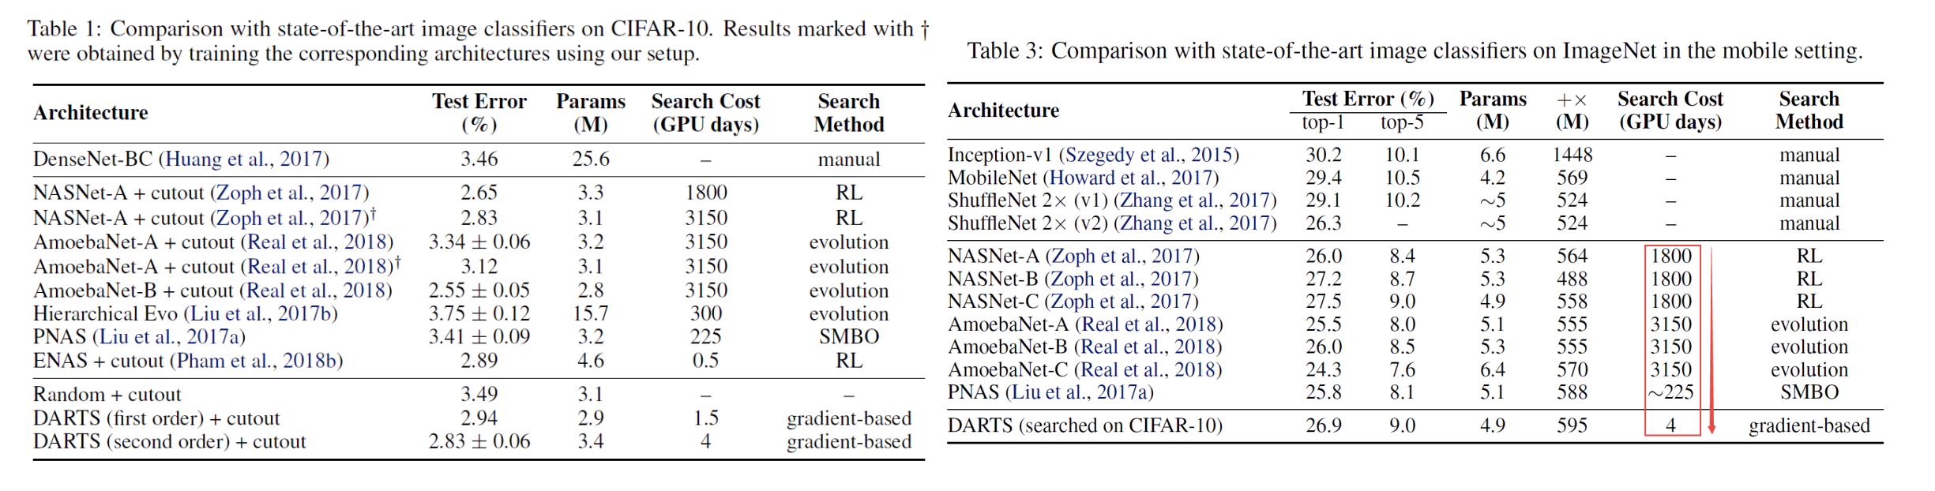
Search Strategy
Darts（Gradient- based）

Slide 24
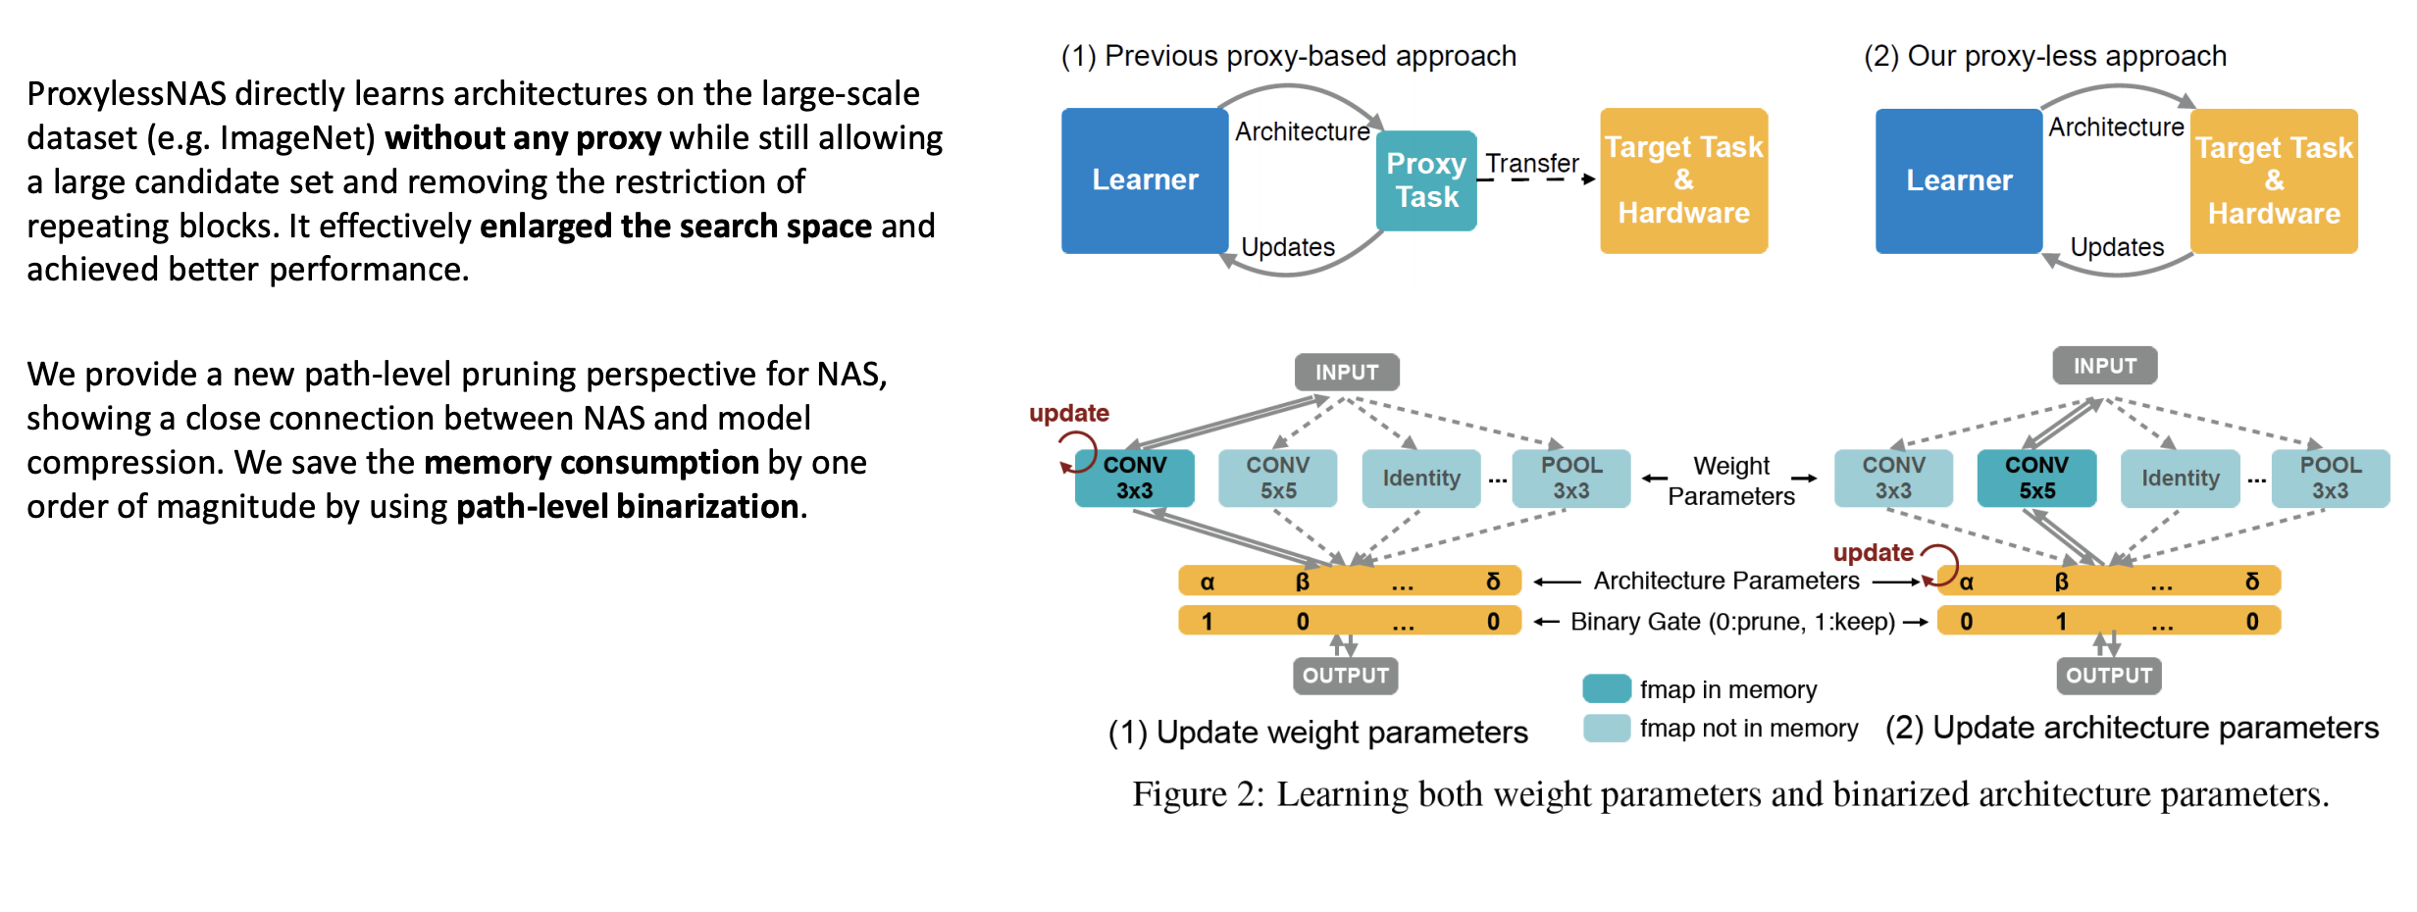
Search Strategy
ProxylessNAS

Slide 25
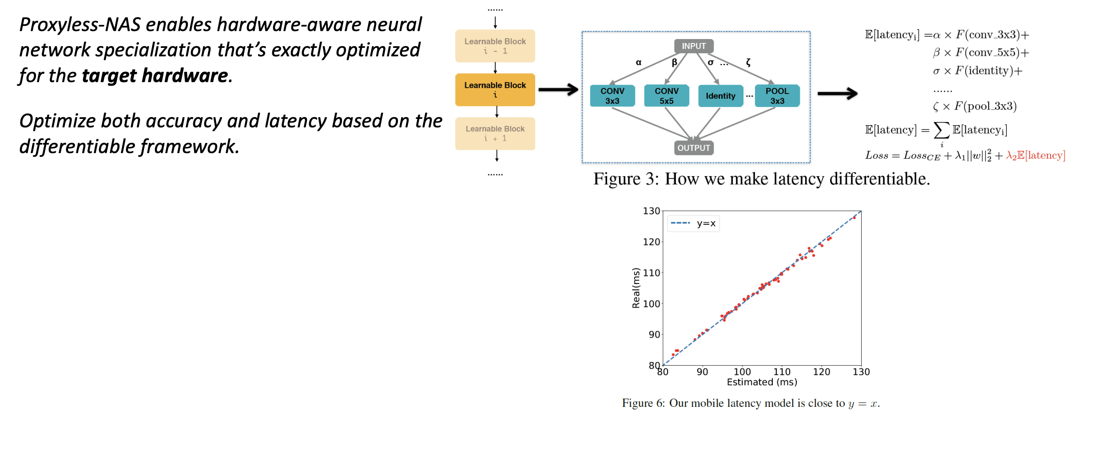
Search Strategy
ProxylessNAS

Slide 26
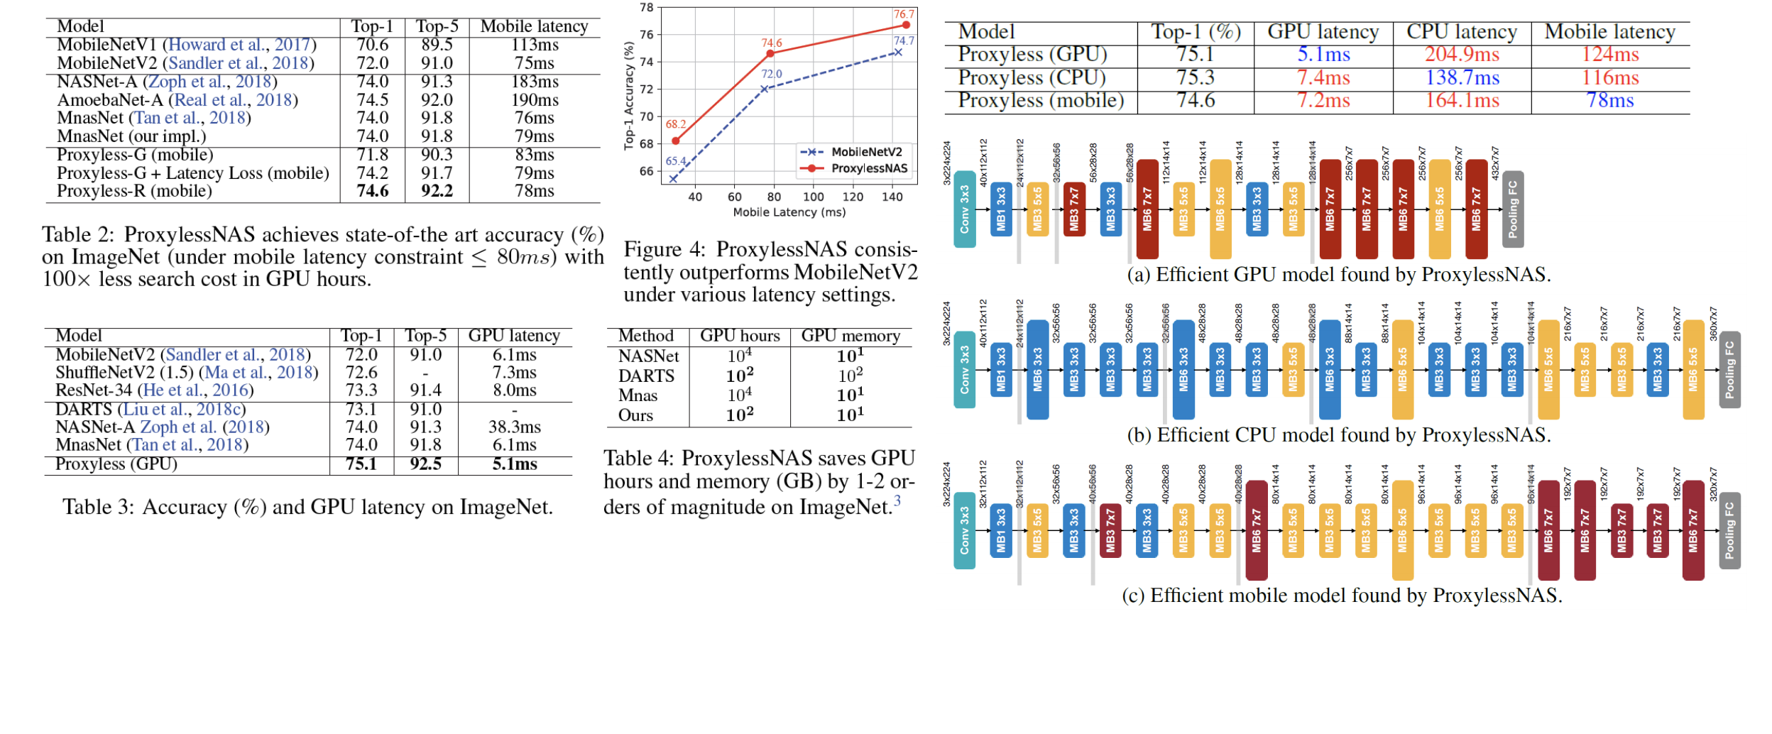
Search Strategy
ProxylessNAS

Slide 27
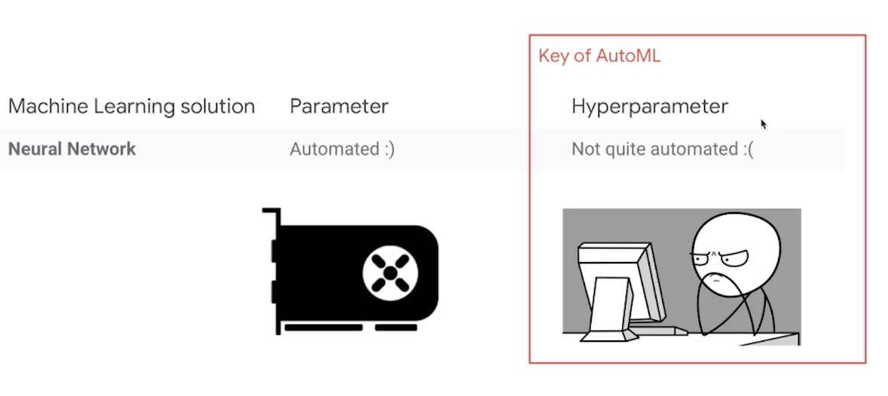
Hyperparameter Optimzation (HPO)
Search method
Grid search
Random search
Skopt (Scikit-learn Optimzation)
http://scikit-optimize.github.io/optimizer/index.html#skopt.optimizer.Optimizer

Slide 28
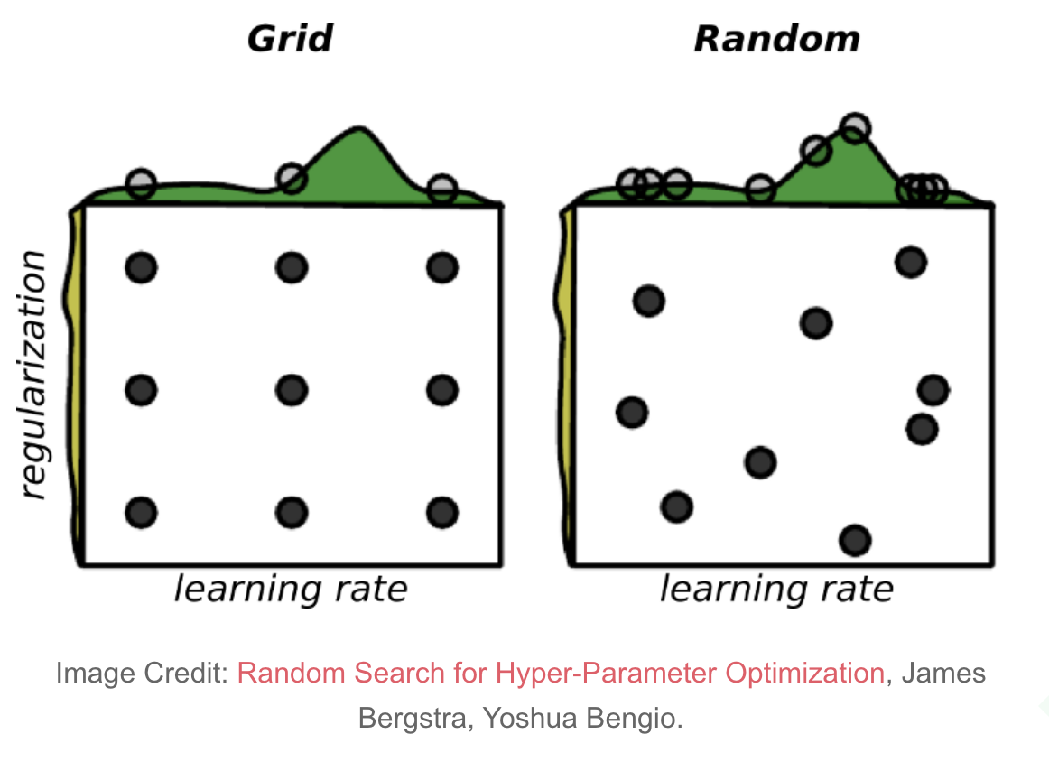
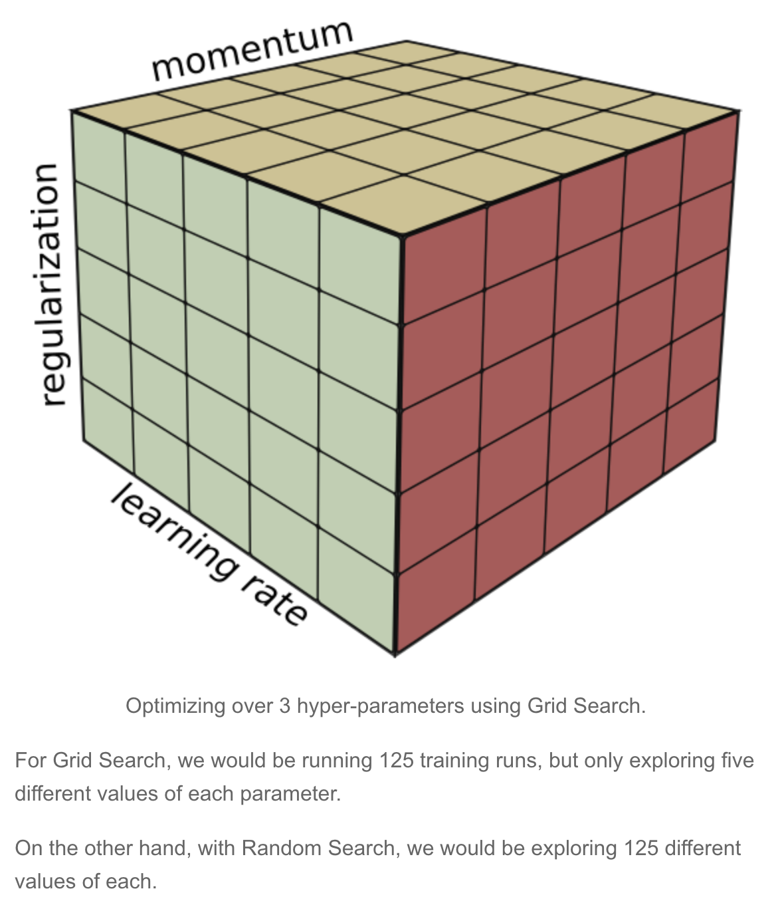
Hyperparameter Optimzation (HPO)
Grid Search is that it is an exponential time algorithm. Its cost grows exponentially with the number of parameters.
In other words, if we need to optimize p parameters and each one takes at most v values, it runs in O(vᵖ) time.

Slide 29
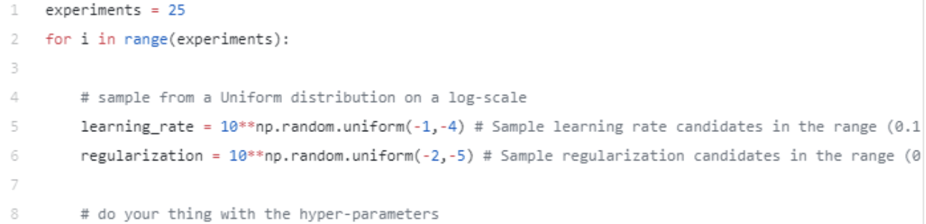
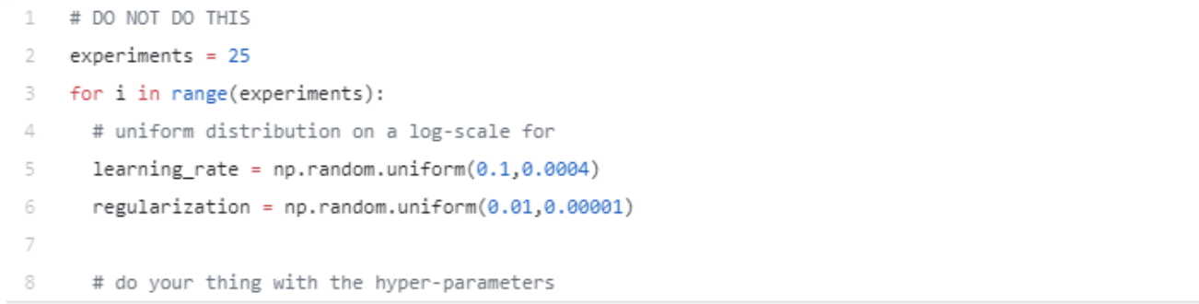
Hyperparameter Optimzation (HPO)
If we want to try values for the learning rate, say within the range of 0.1 to 0.0001, we do:
Note that we are sampling values from a uniform distribution on a log scale.
If we do not use a log-scale, the sampling will not be uniform within the given range. In other words, you should not attempt to sample values like:

Slide 30
Autogluon
https://github.com/awslabs/autogluon

Slide 31
Panel
Suggestions for Autogluon
RL/ES/GB(gradient-based) NAS
Reproducibility for NAS
Pruning or NAS

